Slide 1
Angular Hackathon
¹¹⁹²⁷⁰²
11-September-2023
Aarchishya Kapoor-1192702

Slide 2
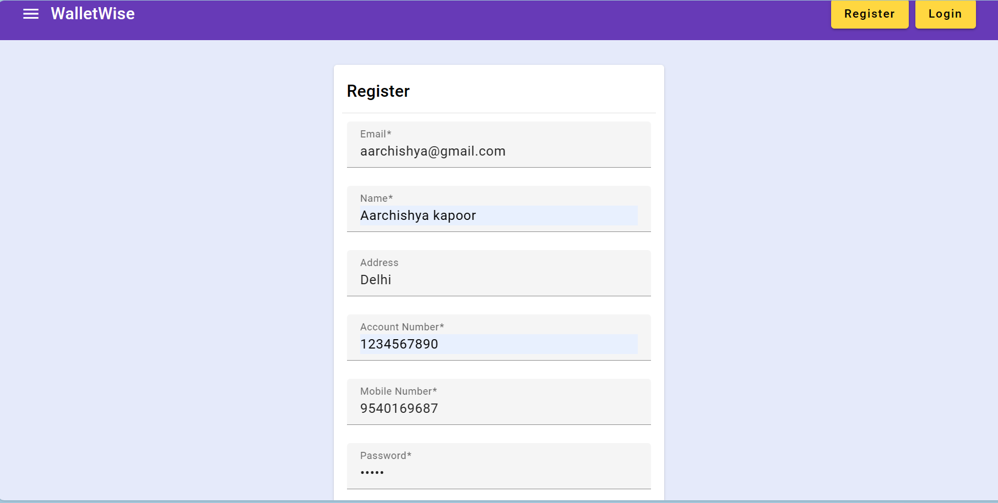
Register form with Validations

Slide 3
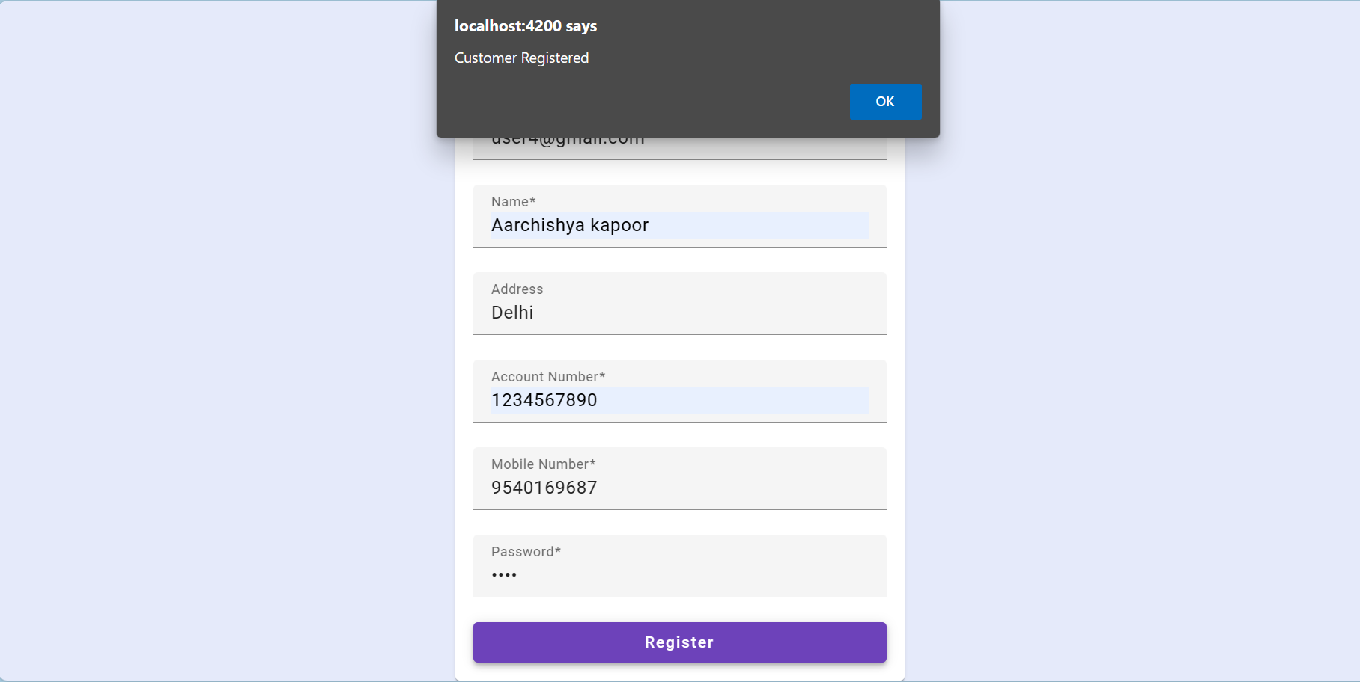
When you register a customer

Slide 4
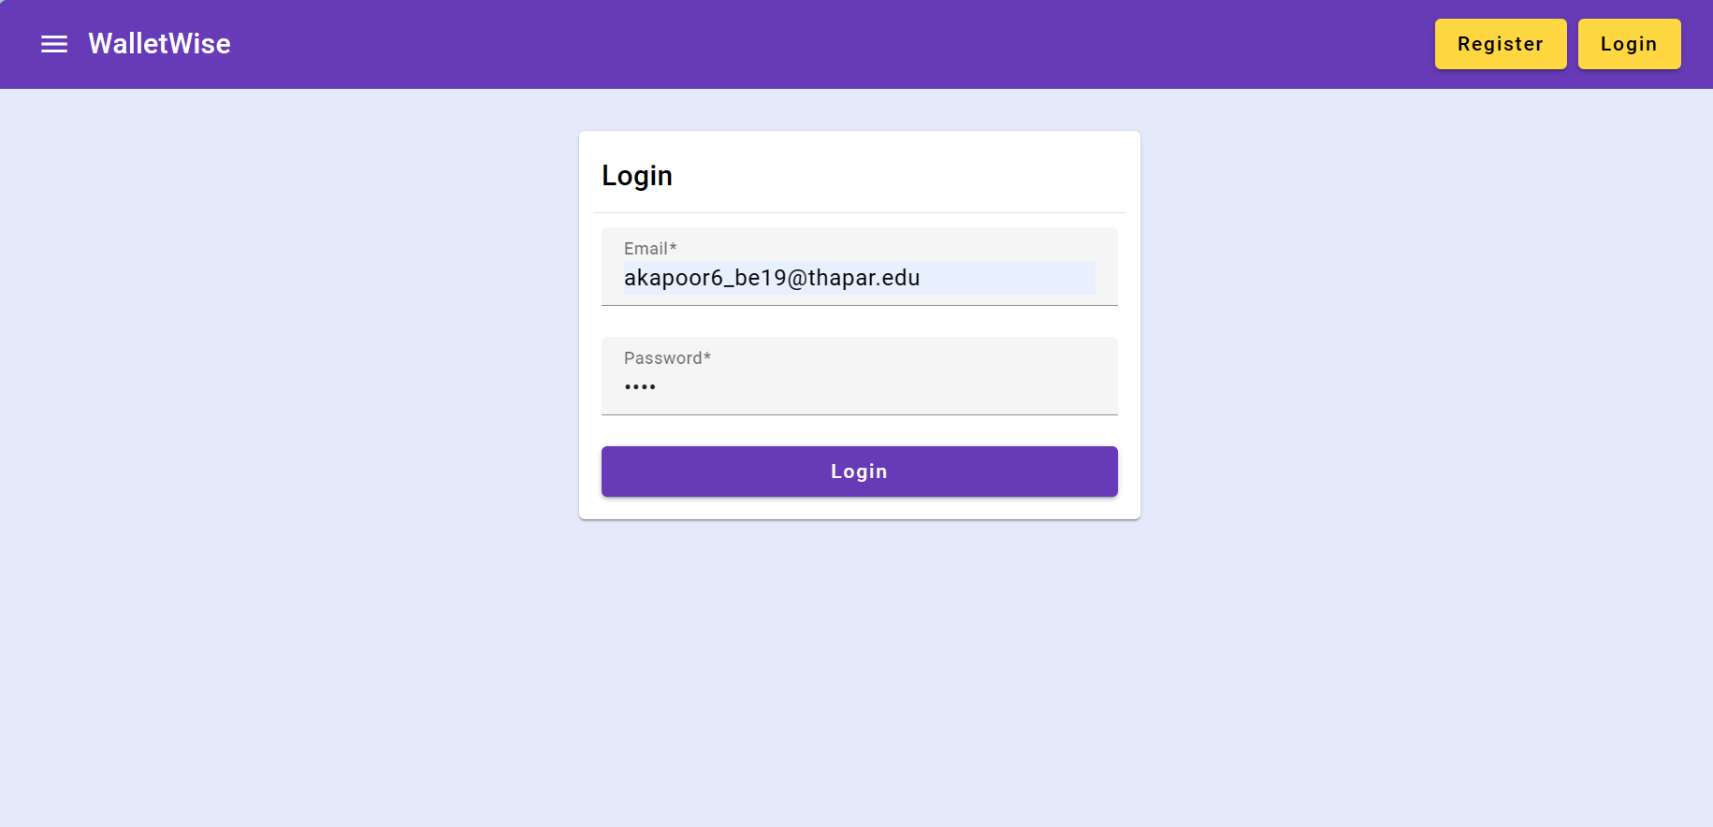
Login form with Validations

Slide 5
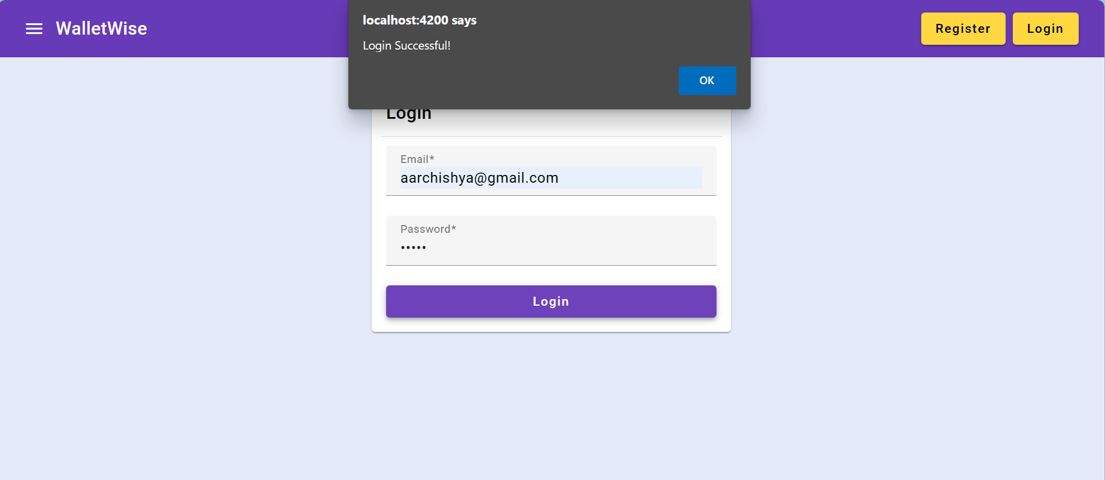
If credentials are valid

Slide 6
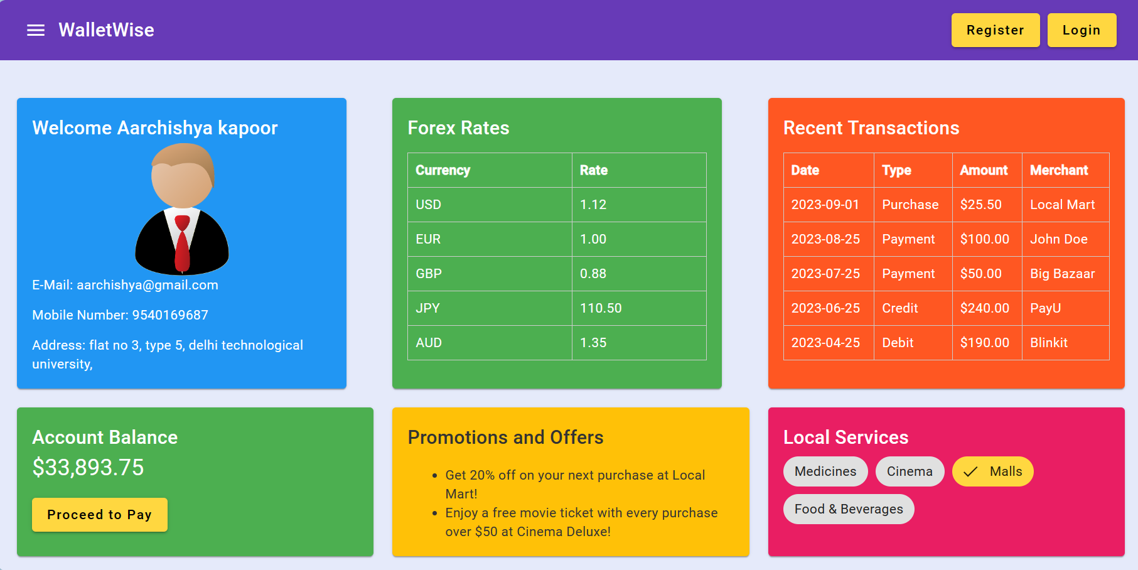
Dashboard for that Particular User

Slide 7
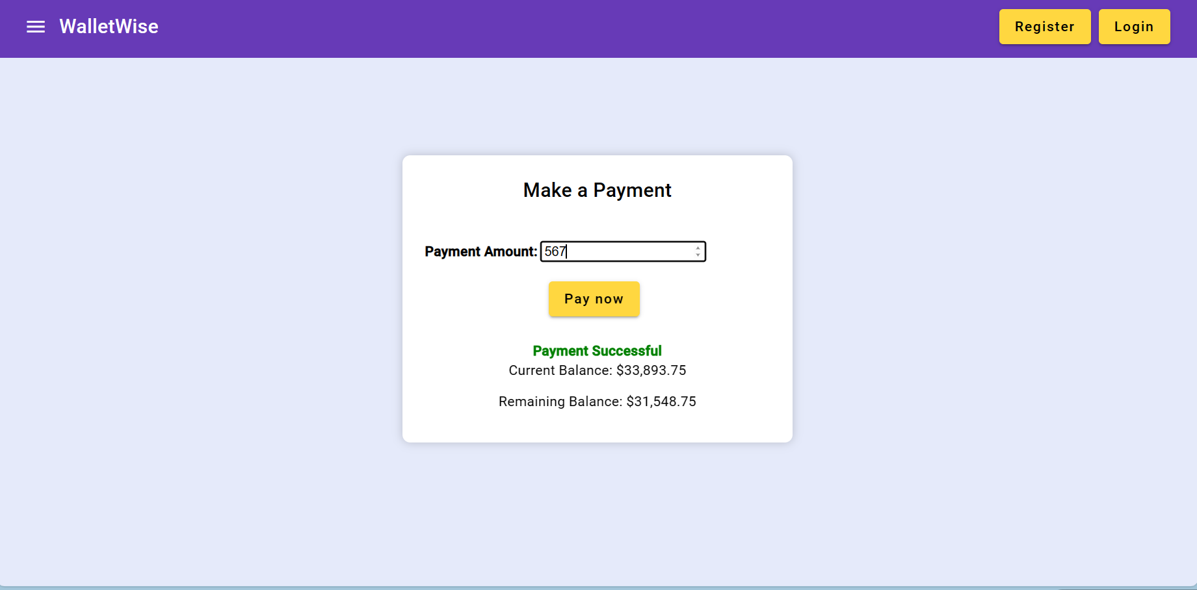
Payment Portal

Slide 8
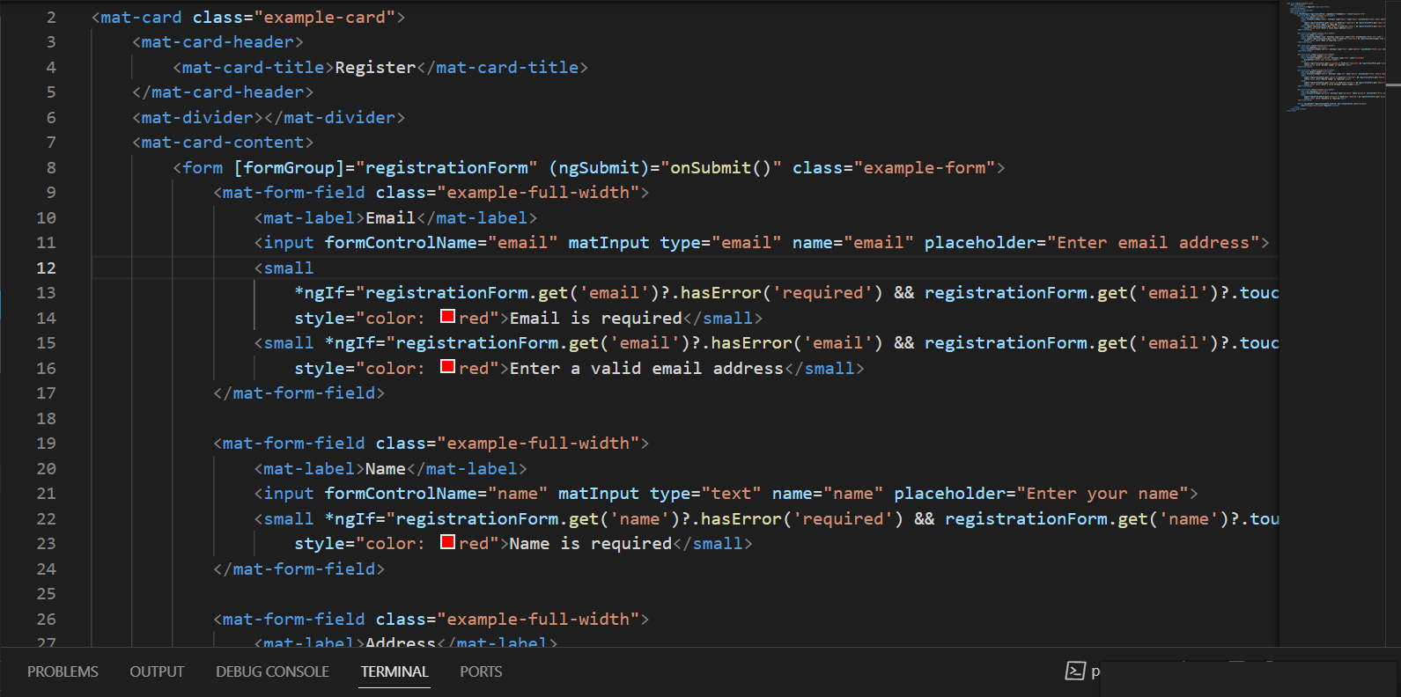
Code- Register Component

Slide 9
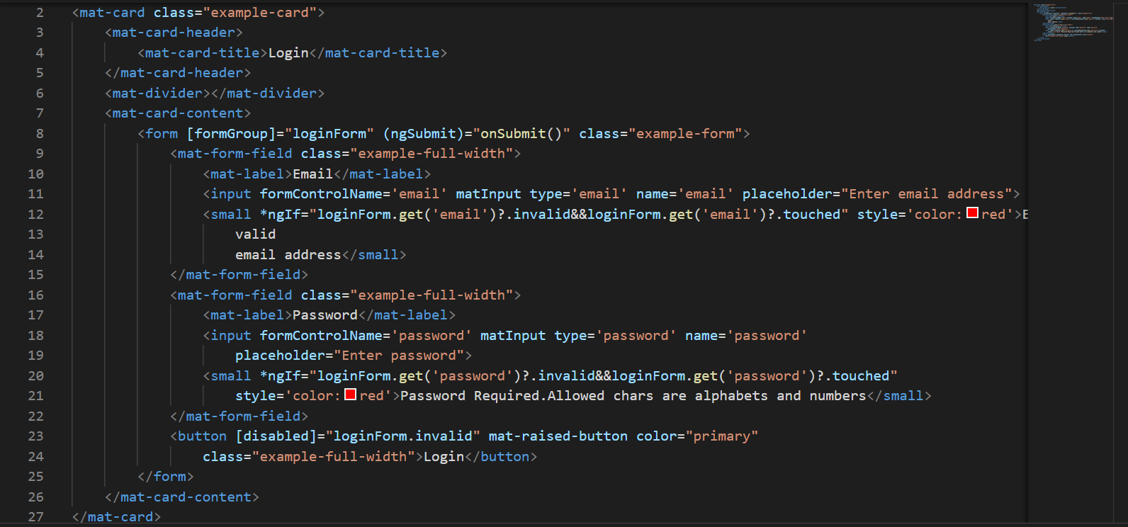
Login component

Slide 10
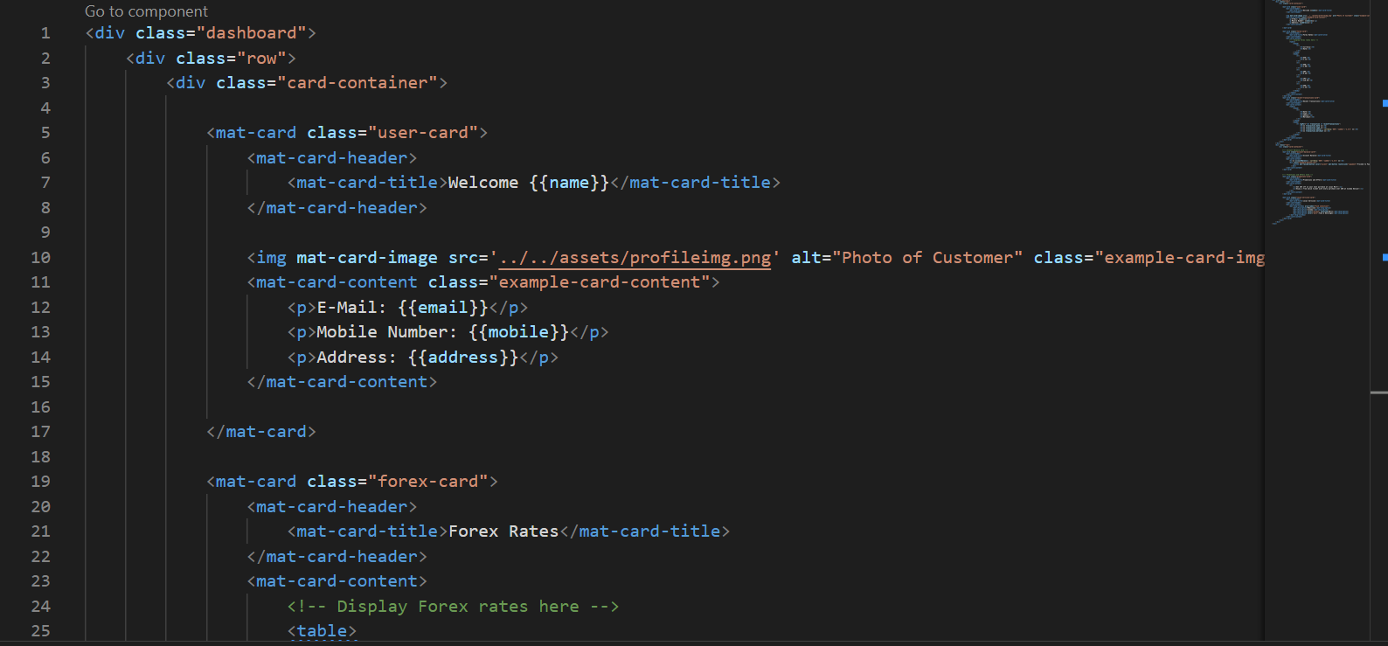
Dashboard component

Slide 11
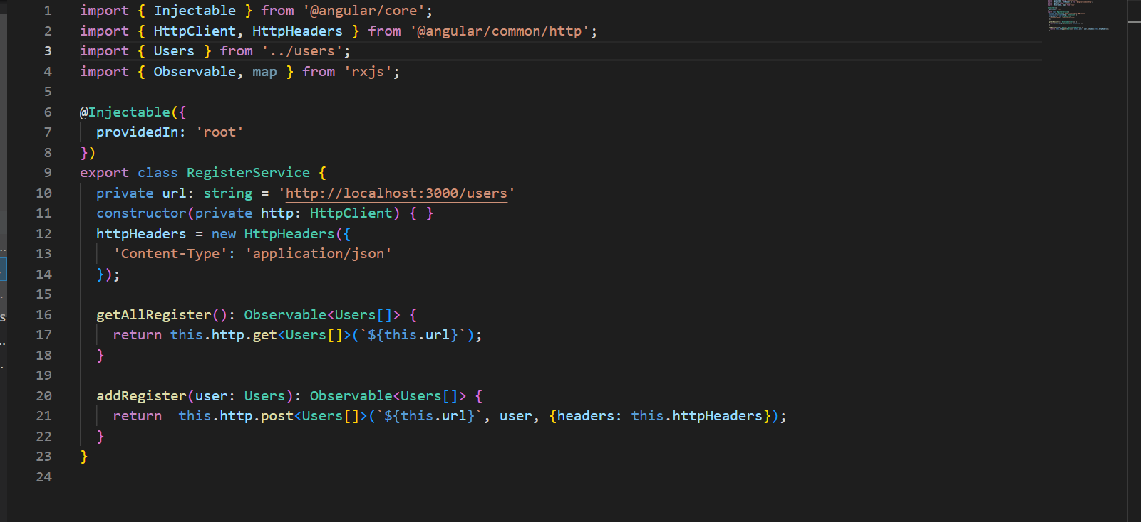
Services

